Slide 1
About Me
Oracle Certified Database Administrator
Sun Certified Java Programmer
Certified Ethical Hacker

Slide 2
Django Views:
Django provides a convenient way to generate dynamic HTML pages by using its template system.
A template consists of static parts of the desired HTML output as well as some special syntax describing how dynamic content will be inserted.

Slide 3
Why Django Template?
In HTML file, we can't write python code because the code is only interpreted by python interpreter not the browser. We know that HTML is a static markup language, while Python is a dynamic programming language.
Django template engine is used to separate the design from the python code and allows us to build dynamic web pages.

Slide 4
Django Template Configuration
To configure the template system, we have to provide some entries in settings.py file.

Slide 5
#Note import os in //settings.py
TEMPLATES = [
{
'BACKEND': 'django.template.backends.django.DjangoTemplates',
'DIRS': [os.path.join(BASE_DIR,'templates')],
'APP_DIRS': True,
'OPTIONS': {
'context_processors': [
'django.template.context_processors.debug',
'django.template.context_processors.request',
'django.contrib.auth.context_processors.auth',
'django.contrib.messages.context_processors.messages',
],
},
},
]

Slide 6
Here, we mentioned that our template directory name is templates. By default, DjangoTemplates looks for a templates subdirectory in each of the INSTALLED_APPS.

Slide 7
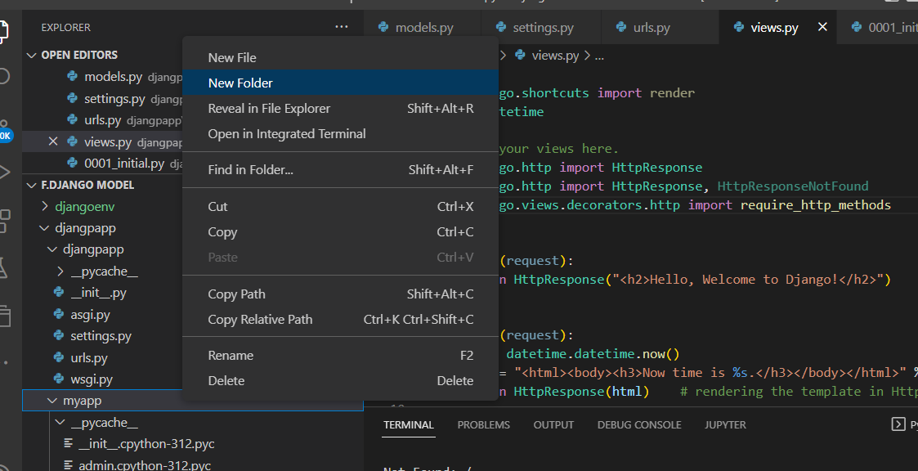
Django Template Simple Example
First, create a directory templates inside the project app as we did below.

Slide 8
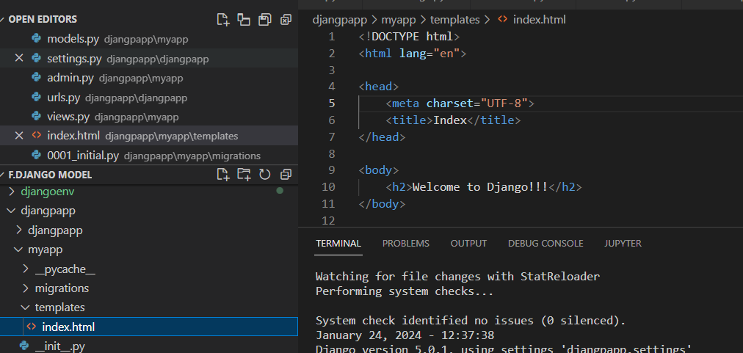
Returning Errors
After that create a template index.html inside the created folder.

Slide 9
Our template index.html contains the following code.
<!DOCTYPE html>
<html lang="en">
<head>
<meta charset="UTF-8">
<title>Index</title>
</head>
<body>
<h2>Welcome to Django!!!</h2>
</body>
</html>

Slide 10
Loading Template
To load the template, call get_template() method as we did below and pass template name.

Slide 11
//views.py
from django.shortcuts import render
#importing loading from django template
from django.template import loader
# Create your views here.
from django.http import HttpResponse
def index(request):
template = loader.get_template('index.html') # getting our template
return HttpResponse(template.render()) # rendering the template in HttpResponse

Slide 12
Set a URL to access the template from the browser.
//urls.py
path('index/', views.index),

Slide 13
Register app inside the INSTALLED_APPS
INSTALLED_APPS = [
'django.contrib.admin',
'django.contrib.auth',
'django.contrib.contenttypes',
'django.contrib.sessions',
'django.contrib.messages',
'django.contrib.staticfiles',
'myapp'
]

Slide 14
Run Server
Execute the following command and access the template by entering localhost:8000/index at the browser.
python manage.py runserver

Slide 15
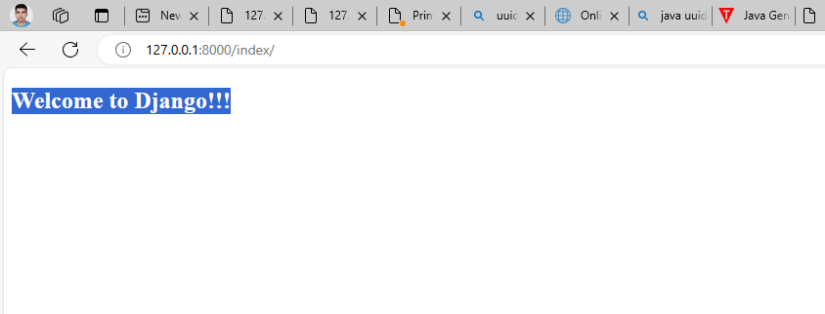

Slide 16
Django Template Language
Django template uses its own syntax to deal with variable, tags, expressions etc. A template is rendered with a context which is used to get value at a web page. See the examples.

Slide 17
Variables
Variables associated with a context can be accessed by {{}} (double curly braces). For example, a variable name value is rahul. Then the following statement will replace name with its value.
My name is {{name}}.
My name is rahul

Slide 18
Django Variable Example
//views.py
from django.shortcuts import render
#importing loading from django template
from django.template import loader
# Create your views here.
from django.http import HttpResponse
def index(request):
template = loader.get_template('index.html') # getting our template
name = {
'student':'rahul'
}
return HttpResponse(template.render(name)) # rendering the template in HttpResponse

Slide 19
Index.html
<!DOCTYPE html>
<html lang="en">
<head>
<meta charset="UTF-8">
<title>Index</title>
</head>
<body>
<h2>Welcome to Django!!!</h2>
<h3>My Name is: {{ student }}</h3>
</body>
</html>

Slide 20
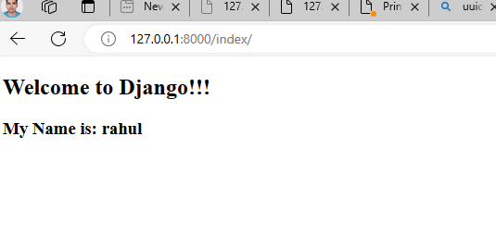
Output:

Slide 21
Tags
In a template, Tags provide arbitrary logic in the rendering process. For example, a tag can output content, serve as a control structure e.g. an "if" statement or a "for" loop, grab content from a database etc.
Tags are surrounded by {% %} braces. For example.
{% csrf_token %}
{% if user.is_authenticated %}
Hello, {{ user.username }}.
{% endif %}

